Slide 1

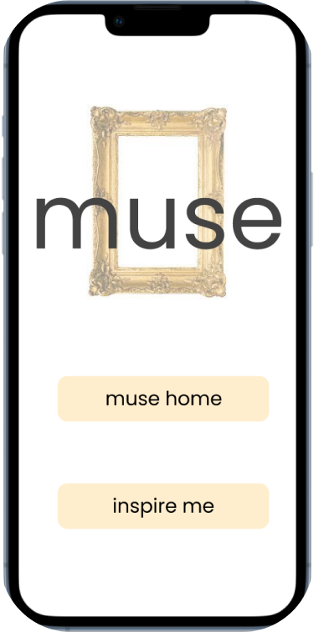
Inspire. Purchase. Share.
Chirag Huria, Alana Mittleman, Rohan Paliwal, Elias El Kozah
for Digital Service Innovation
Notes:
Greeting: Hello [investor, greeting] we are muse, (individual intros, include personal details if you have something in common with the investor)

Slide 2
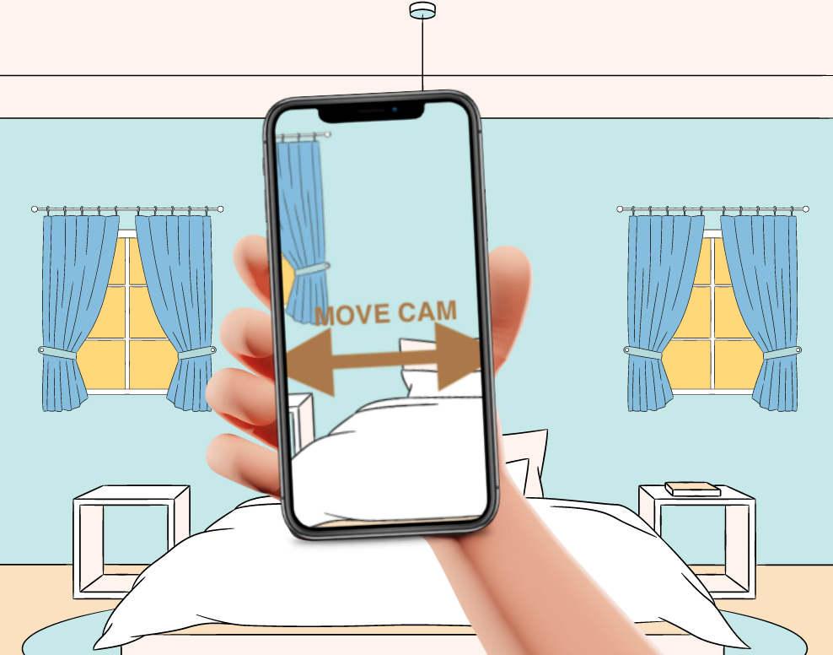
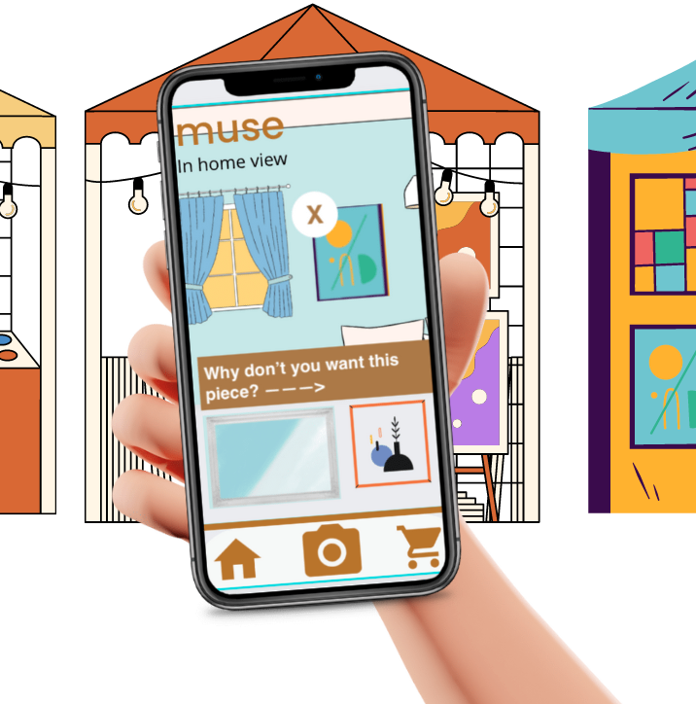
What is muse?
MUSE | Investor Pitch | Chirag Huria, Alana Mittleman, Rohan Paliwal, Elias El Kozah
Notes:
Muse is a service that allows users to carry with them what the walls of their home looks like, so that when they are out and about and see art they like, they can instantly see what it would look like in their home and decide whether to buy it.

Slide 3
What is muse for artists?
Direct feedback from fans and customers
The ability to reach new customers
MUSE | Investor Pitch | Chirag Huria, Alana Mittleman, Rohan Paliwal, Elias El Kozah
Notes:
When art buyers use muse, they can provide feedback about pieces they decide they cannot buy. With this information, artists can make informed decisions about who might want to buy their work in the future or how they could change their work to enable more people to buy it in ways that won’t compromise their style.
This is valuable information that could help artists who want to sell more of their work do so, but larger entities such as galleries and academic institutions can also benefit from this data.

Slide 4
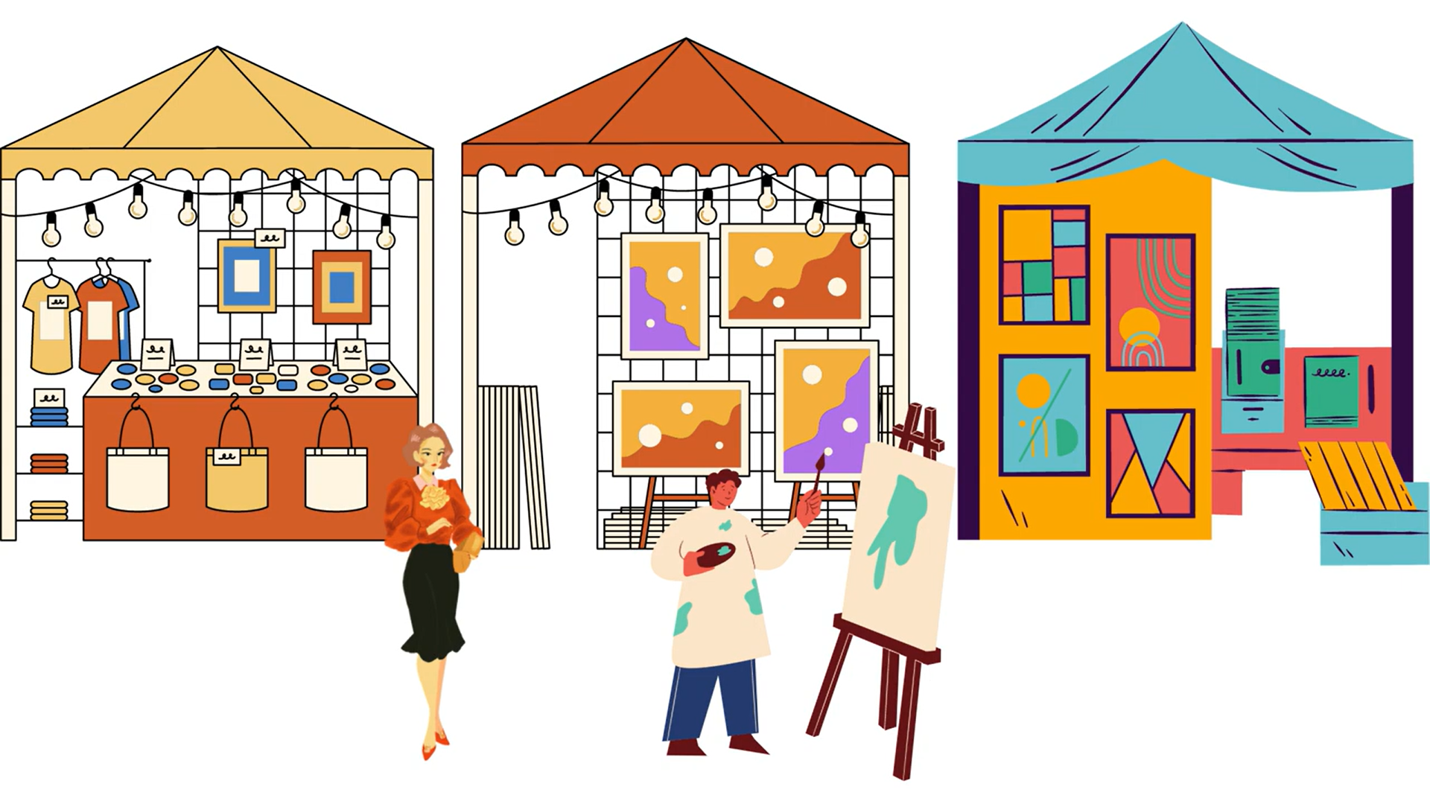
Imagine you are at an art festival
MUSE | Investor Pitch | Chirag Huria, Alana Mittleman, Rohan Paliwal, Elias El Kozah
Notes:
To understand the value muse brings to the art buyer, we would like to ask you to imagine you are at an art festival. You are interested in buying a piece of art to hang on your wall but you’re not sure what to get. As you walk through the festival, you see many pieces that catch your eye. Don’t blink now. (flip through paintings from local artists, you don’t have to say who they’re by)

Slide 5
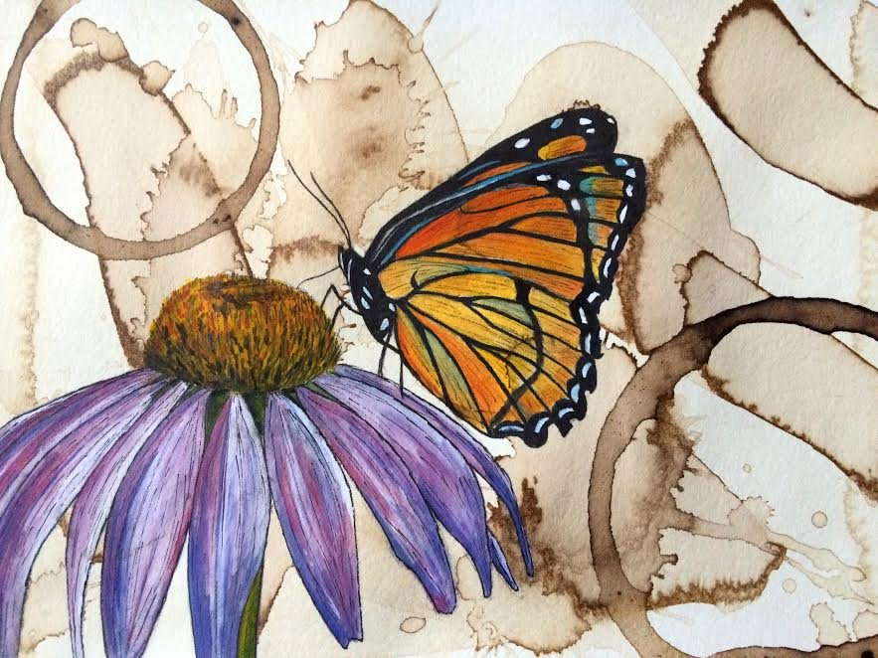
Notes:
Craig Peterson

Slide 6
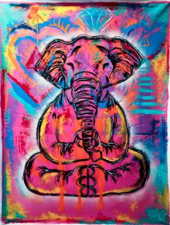
Notes:
Baron bat

Slide 7

Notes:
Unknown artist

Slide 8
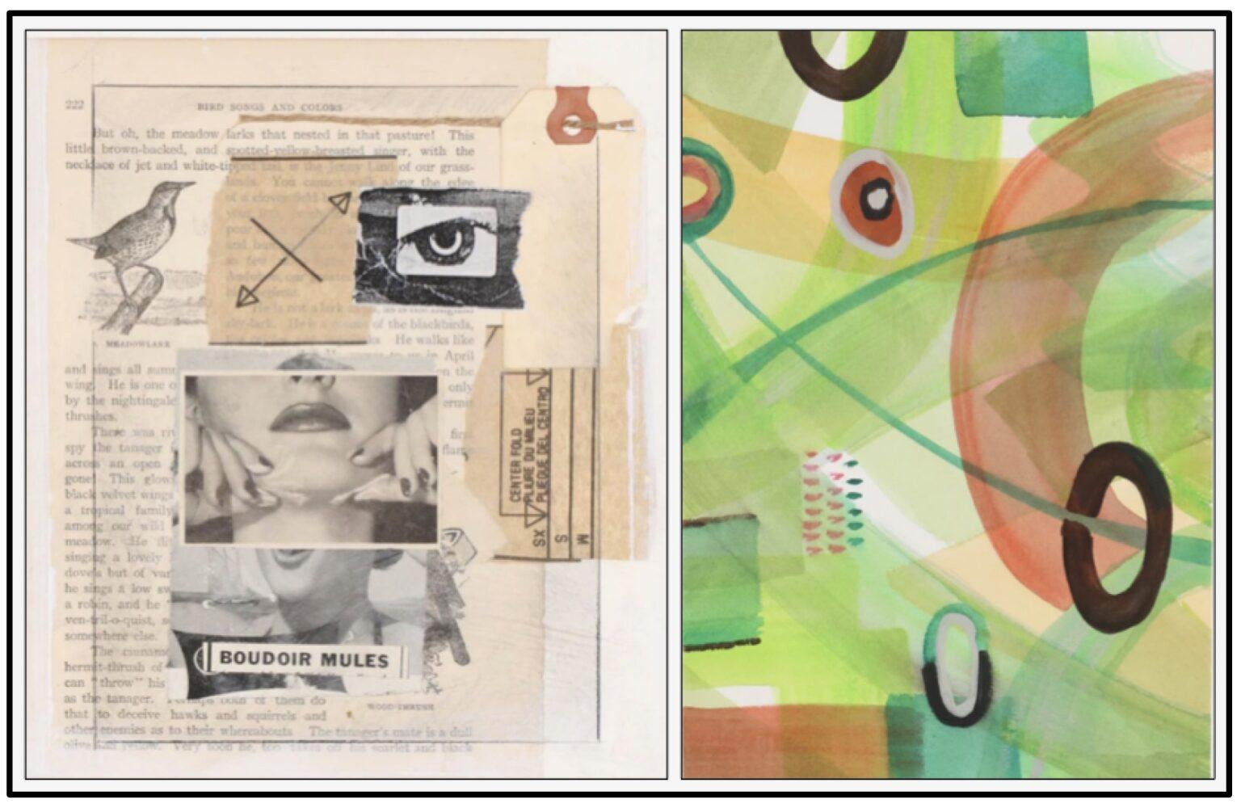
Notes:
Jerome D’Angelo, “Boudoir Mules”

Slide 9
Notes:
Kathleen Zimbicki, “untitled”

Slide 10
That’s a lot for our minds to process, imagine, and decide.
We get it. Art buying is tough and takes time.
MUSE | Investor Pitch | Chirag Huria, Alana Mittleman, Rohan Paliwal, Elias El Kozah
Notes:
=

Slide 11
Could you make a good choice ending up with art that will look good in your home?
After getting these glimpses, can you imagine one of these pieces in your living space?
MUSE | Investor Pitch | Chirag Huria, Alana Mittleman, Rohan Paliwal, Elias El Kozah
Notes:
After getting those glimpses, Could you make a good choice ending up with art that will look good in your home?
After getting these glimpses, can you imagine one of these pieces in your living space?
A recent report found that 54% of consumers experience so much frustration that they abandon e-commerce sites if they can't choose, and in our field research we found that this struggle transfers to shopping for art in person. Choice overload is part of the problem and muse is the solution.

Slide 12
muse can help you answer those questions.
Experience art in your living space, from anywhere.
MUSE | Investor Pitch | Chirag Huria, Alana Mittleman, Rohan Paliwal, Elias El Kozah
Notes:
Muse can help you change the answers to those questions to yes. With muse, you can experience art in your living space, from anywhere.

Slide 13

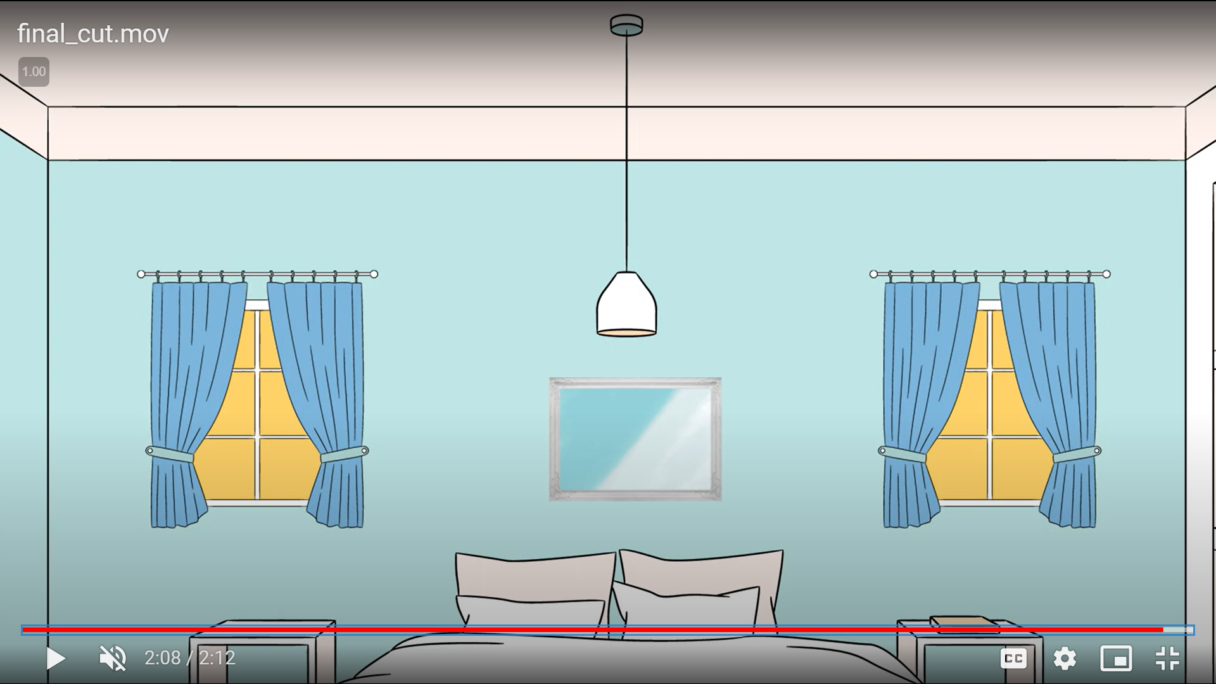
Notes:
For customers like dylan….

Slide 14
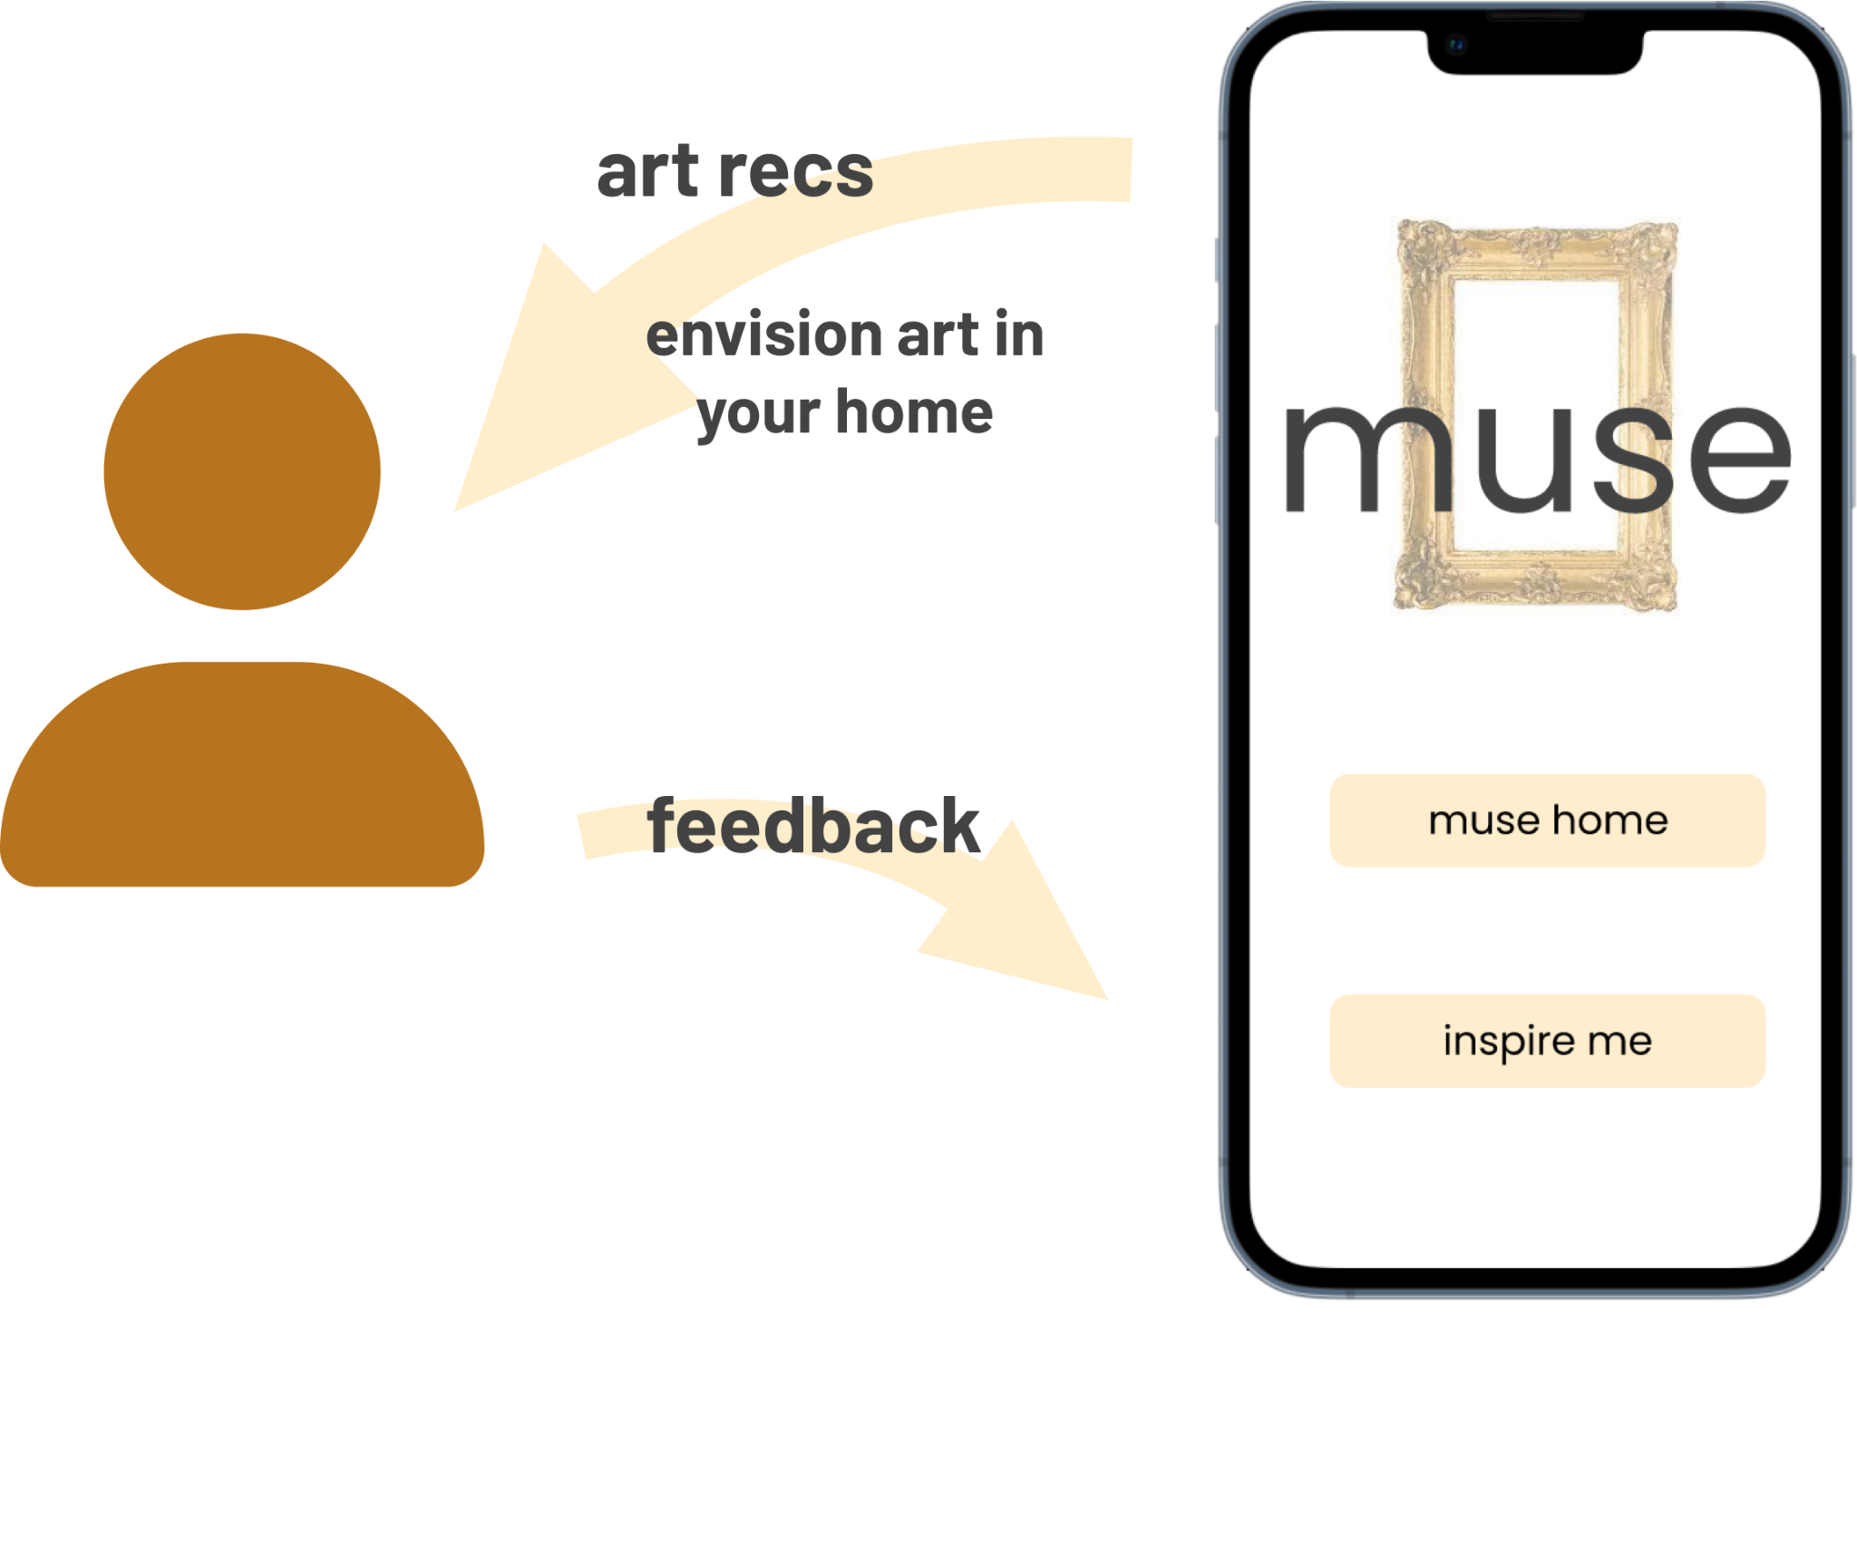
Value Flow
MUSE | Investor Pitch | Chirag Huria, Alana Mittleman, Rohan Paliwal, Elias El Kozah
Notes:
With muse, art buyers are able to see art in their homes from anywhere, and receive recommendations for new art if they find that pieces they like don’t look good in their homes.
And art buyers are able to provide feedback about pieces they decide they cannot buy.
With this information, artists can make informed decisions about who might want to buy their work in the future or how they could change their work to enable more people to buy it in ways that won’t compromise their style.
Therefore, we see revenue coming in in two ways. One, as the intermediary for purchases and art recommendations, muse can benefit from service fees. And two, in individuals or collectives of artists paying for information about how muse users shop for art to increase sales or improve relationships with buyers.

Slide 15
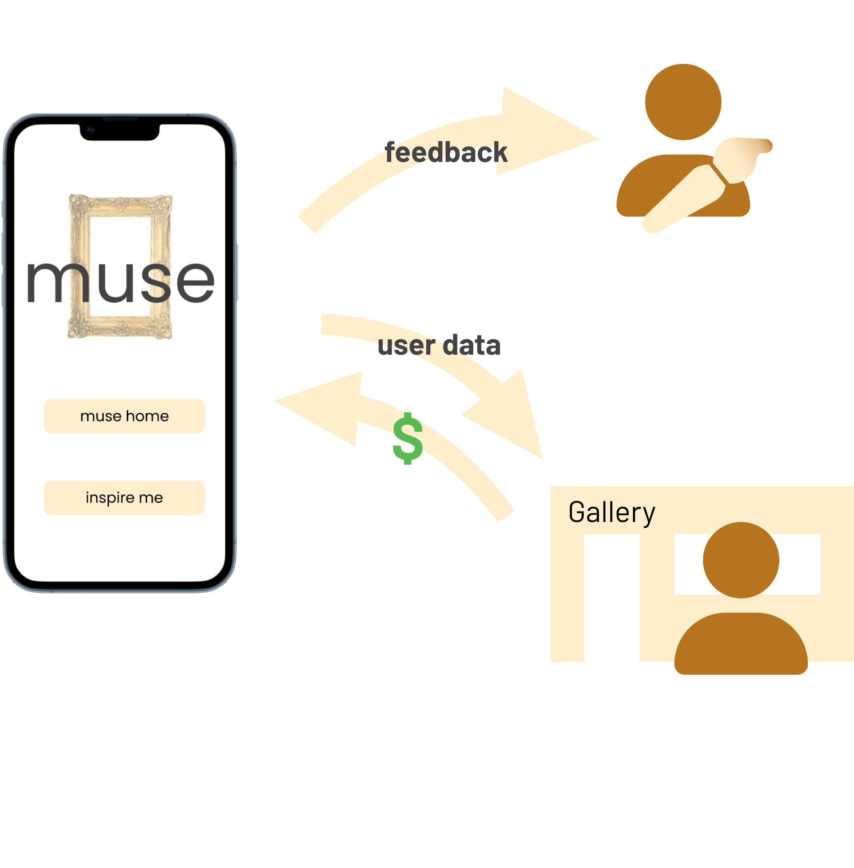
Value Flow
MUSE | Investor Pitch | Chirag Huria, Alana Mittleman, Rohan Paliwal, Elias El Kozah
Notes:
On the other hand, with feedback from users artists can make informed decisions about who might want to buy their work in the future or how they could change their work to enable more people to buy it in ways that won’t compromise their style. We also hope for these artists to be able to provide recommendations directly back to their potential customers.
Therefore, we see revenue coming in in two ways. One, as the intermediary for purchases and art recommendations, muse can benefit from service fees. And two, in individuals or collectives of artists paying for information about how muse users shop for art to increase sales or improve relationships with buyers.

Slide 16
Q&A

Slide 17
appendix

Slide 18
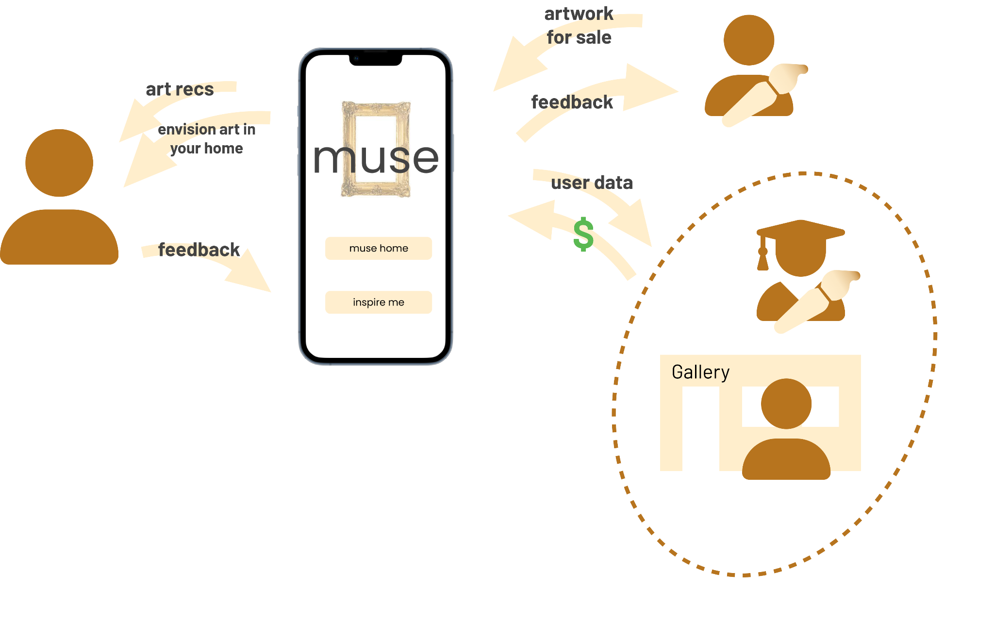
Value Flow
MUSE | Investor Pitch | Chirag Huria, Alana Mittleman, Rohan Paliwal, Elias El Kozah
Notes:
Full value flow

Slide 19
What muse offers?
They need to place to connect and communicate A platform that pulls artists and art lovers together
They needs tools to facilitate their communications Tools to facilitate art buying (Art visualisation using Augmented Reality)
They needs insights to be matched together Data collection and interpretation that facilitates the match between artists and art lovers (Buying and selling)
MUSE | Investor Pitch | Chirag Huria, Alana Mittleman, Rohan Paliwal, Elias El Kozah

Slide 20
Solving the Chicken and the Egg Problem
We want to bring to the platform 1000 art sellers in pittsburgh area
University students interested in selling art (CMU & PITT art students)
Street art exhibitors
Local art galleries
We want to bring to the platform 2000 art enthusiasts
University students interested in art (CMU & PITT art students)
Museum and art gallery visitors
MUSE | Investor Pitch | Chirag Huria, Alana Mittleman, Rohan Paliwal, Elias El Kozah

Slide 21


How are we different?
Amazon View in your Room
Free
Minimum Specs: Runs on iOS 7 and Android 11
Available within the Amazon Shopping App only
muse
muse is a platform
muse facilitates interaction between artists and art buyers
It provides an AR tool for art lovers to visualize
art before buying and suggestions to help them decide
It provides analytics and insights to artists and creators
Wallary
See how a picture looks on your wall
It’s only a tool to visualize pictures and art
2$ / Month

Slide 22
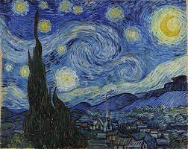



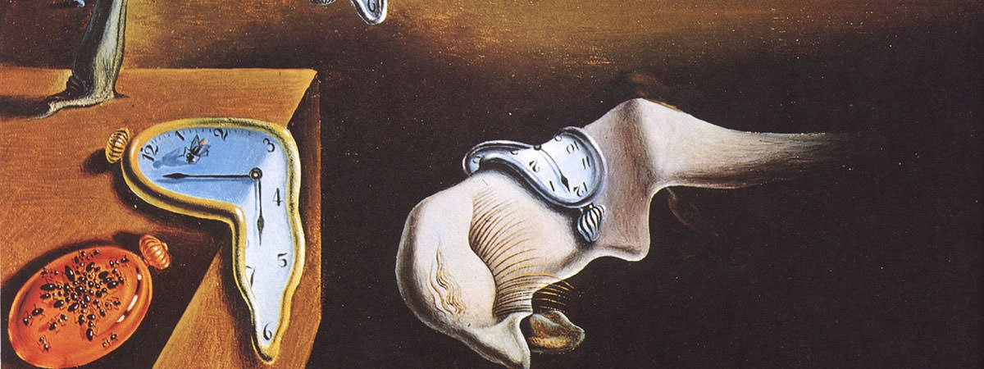

Excited?
Confusion?
Buy?
MUSE
Making art accessible
Alternate Cover Page
Alana Mittleman, Chirag Huria, Elias El Kozah, Rohan Paliwal
Scan.
Decide.
Digital Service Innovation (Spring 2022)
Carnegie Mellon University

